Slide 1

Are there regional difference between vehicular accidents?
Curtis Zhuang

Slide 2
Dataset
FARS/CRSS Coding and Validation Manual
1906184 entries
1996 - 2016
Notes:
National Highway Traffic Safety Administration
Fatality Analysis Reporting System (FARS) and the Crash Report Sampling System (CRSS).

Slide 3
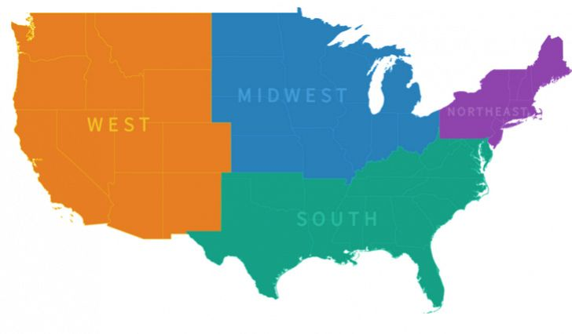
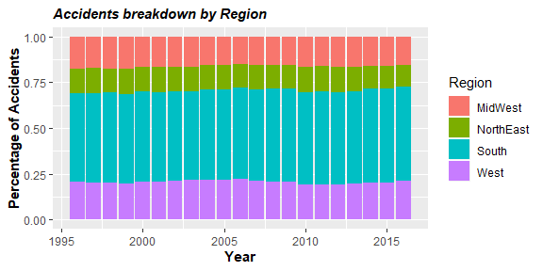
Regions
Midwest
21% population
16% accidents
Northeast
17% population
12% accidents
South
38% population
50% accidents
West
24% population
22% accidents
Source: census.gov
Notes:
Source: census.gov https://www.census.gov/popclock/print.php?component=growth&image=//www.census.gov/popclock/share/images/growth_1561939200.png

Slide 4
Variables & Methods
Region
Sex
Collision type
No. of ppl involved
Severity
Age
forcats
ggplot2
gridExtra
dplyr
tidyr

Slide 5
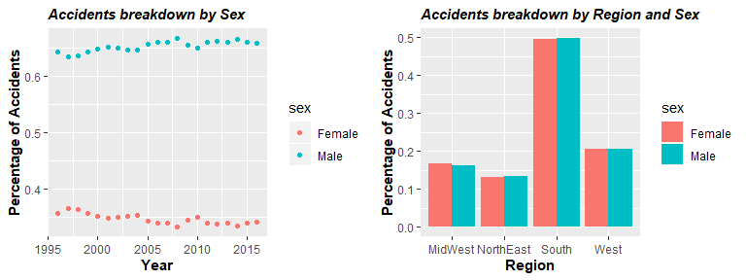
Sex
Constant across the time period
No regional effect

Slide 6
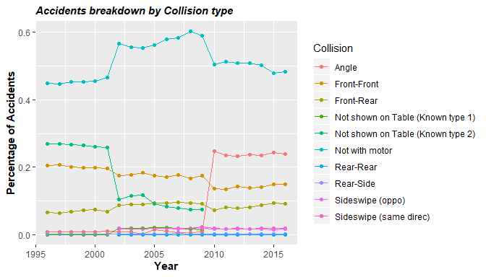
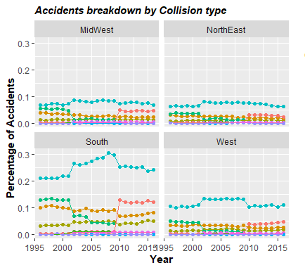
Type of collision
Overall trend and South alike
Exists regional effect

Slide 7
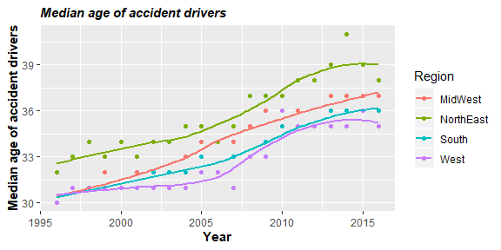
Age
Growing trend over time
Regional effect exists
Notes:
Growth: Midwest largest, west smallest
Median: Northeast largest

Slide 8
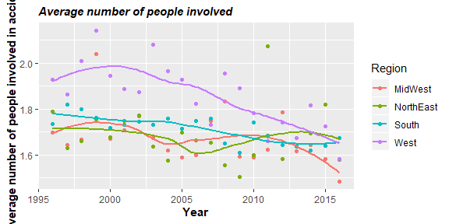
Number of people involved
Downward sloping trend
Regional effect exists
Notes:
West
In the end three meets and Midwest lowest

Slide 9
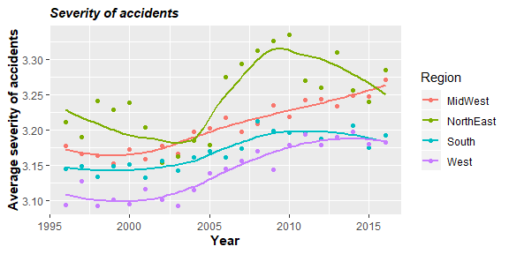
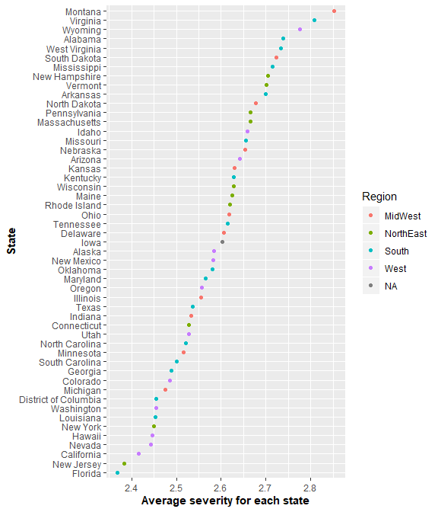
Severity
Increase over time
No clustering of states
Regional effect not clear
Notes:
No clustering of states
2: Suspected Minor Injury
3: Suspected Serious Injury

Slide 10
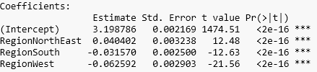

More on to severity regional effect
$Severity= α_{1}NE+α_{2}South$+ $α_{3}West+β$
Exists regional effect

Slide 11
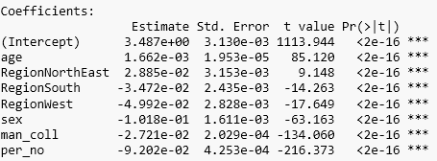
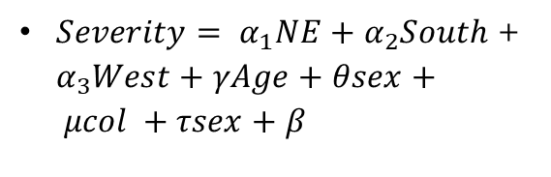
Extended model
$Severity= α_{1}NE+α_{2}South$+ $α_{3}West+γAge+θsex+ μcol +τsex+β$

Slide 12
Conclusion
Regional effect do exist
Collision type
Age
People involved
Severity is impacted by many factors
Notes:
NE more severe
South more accidents
My model only accounts for 5% severity

Slide 13

Questions

